Slide 1
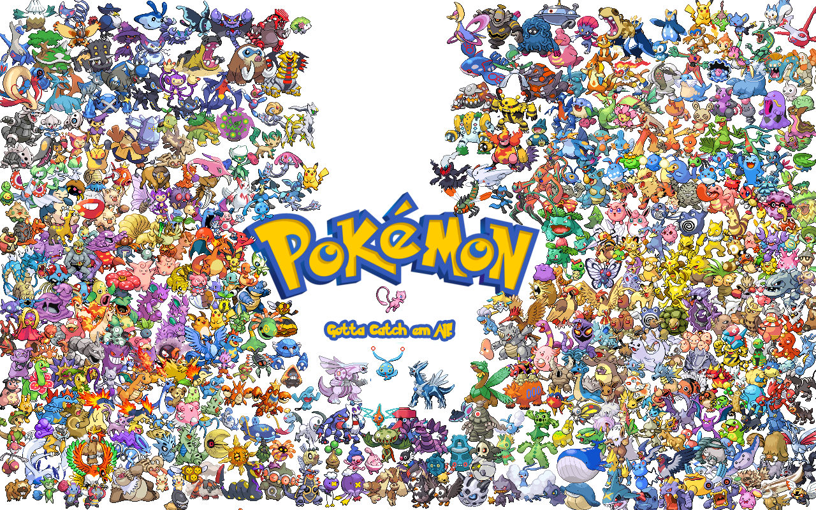
By:
Alex Morsey
Bryce Baker
Gregg McMillion

Slide 2

We created the Pokemon Menu Displaying:
Pokedex
Pokemon Party
Items
Badges

Slide 3
Each menu option using various techniques we’ve learned in Data Structures such as:
Binary Trees
Queues
Bubble Sort
Selection Sort
Stacks
Hashings

Slide 4
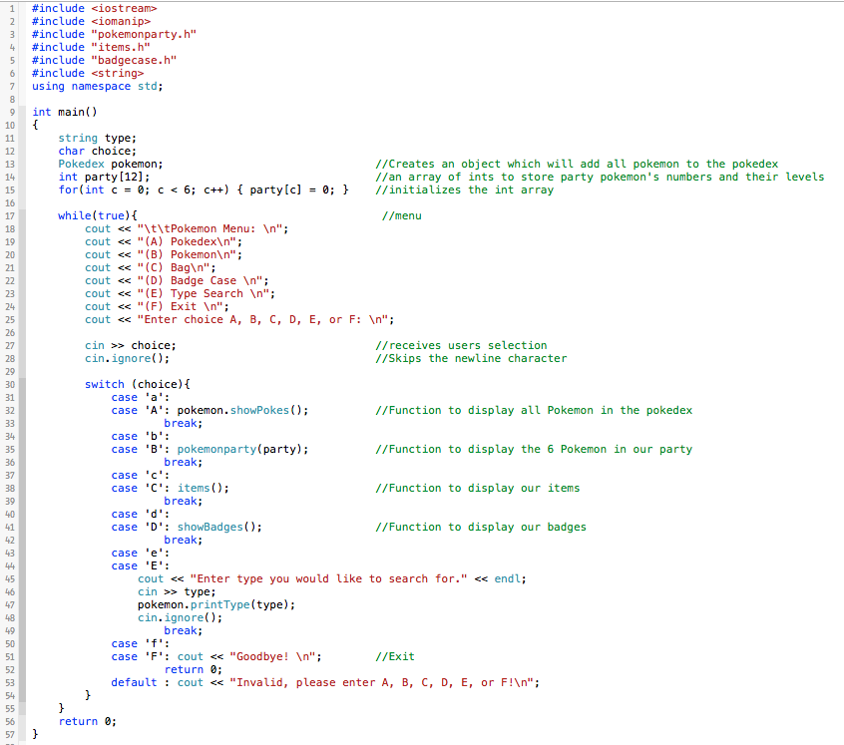
Main.cpp
Uses switch cases to navigate the menu
Each case calls a different function which are located in separate header files.

Slide 5
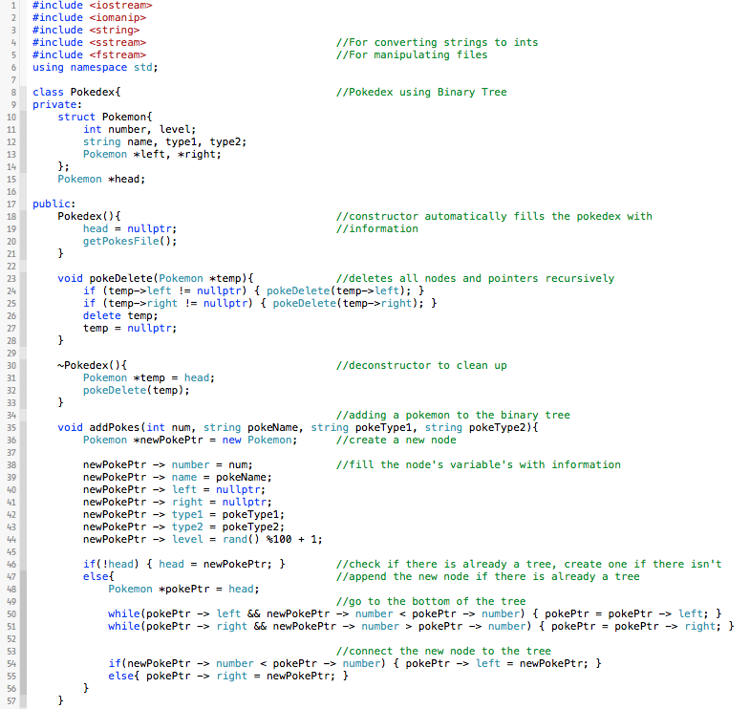
Case A.) Pokedex
When the program starts, and the Pokemon class is defined in main, this will build our pokedex
It will grab the name of each 151 Pokemon from a txt file we have, and add them to the binary tree

Slide 6
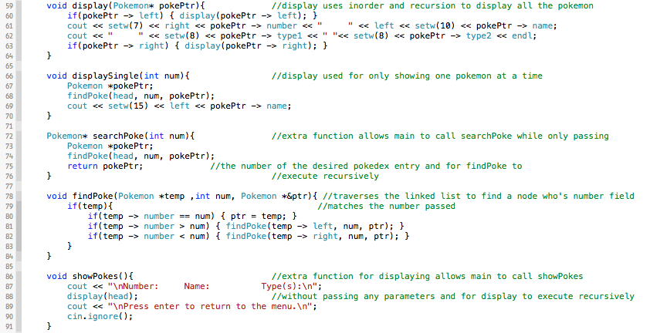
Case A.) Pokedex
This is a continuation of the Pokedex file where it displays pokemon, should the user pick Case A.

Slide 7
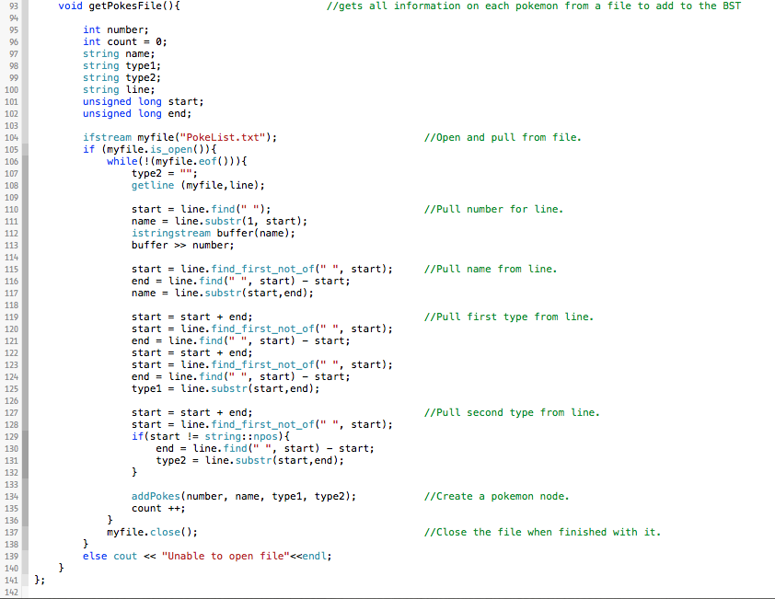
Case A.) Pokedex
This is our function which gets all information from the txt file.

Slide 8
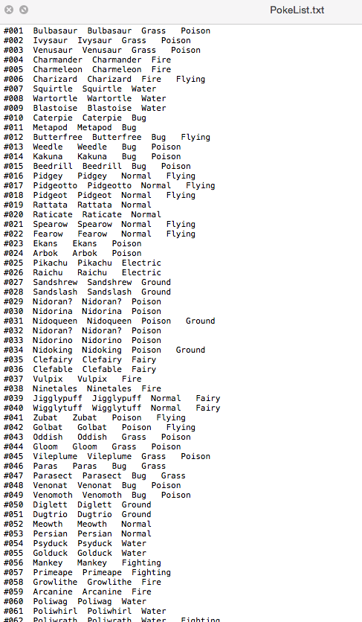
Txt File
Here is an example of what the txt file looks like
Lists: Number, Name, and Type

Slide 9
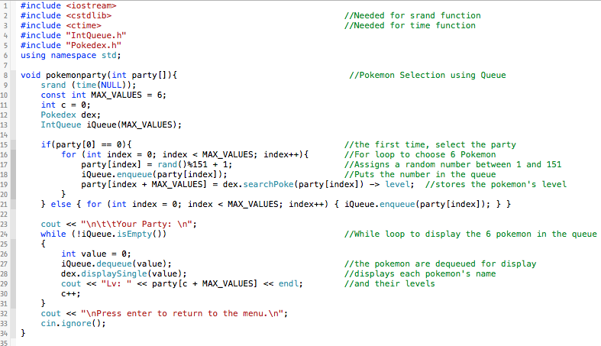
Case B.) Pokemon Party
When we choose case B, pokemon party function will be called which randomly selects 6 Pokemon for our party. Also uses queue’s.

Slide 10
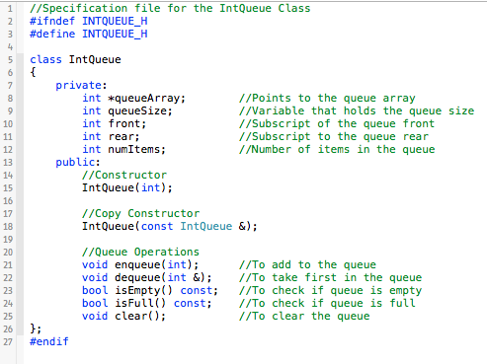
Case B.) Pokemon Party
Queue class and its funtions

Slide 11
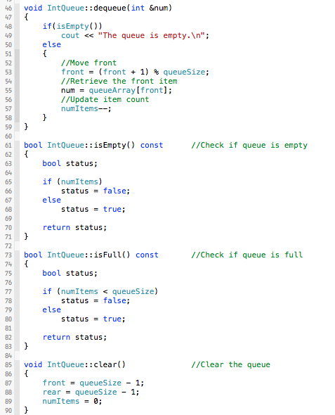
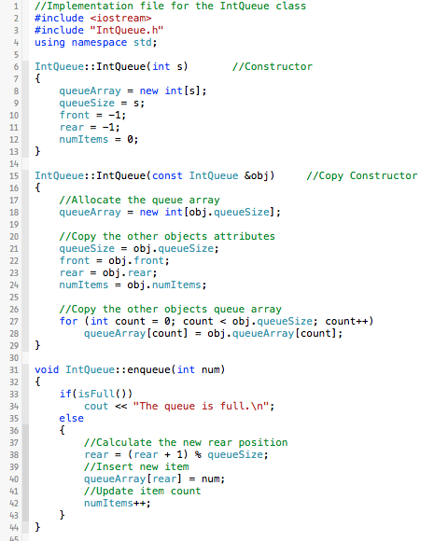
Case B.) Pokemon Party
Queue Implementation

Slide 12
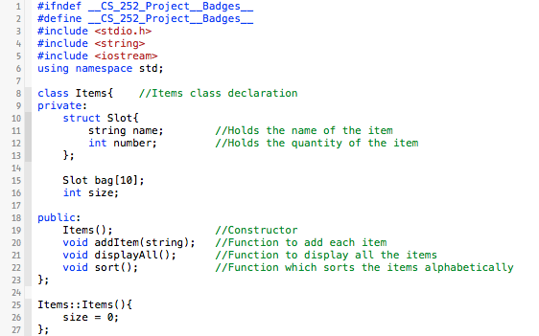
Case C.) Bag
Items class and its funtions

Slide 13
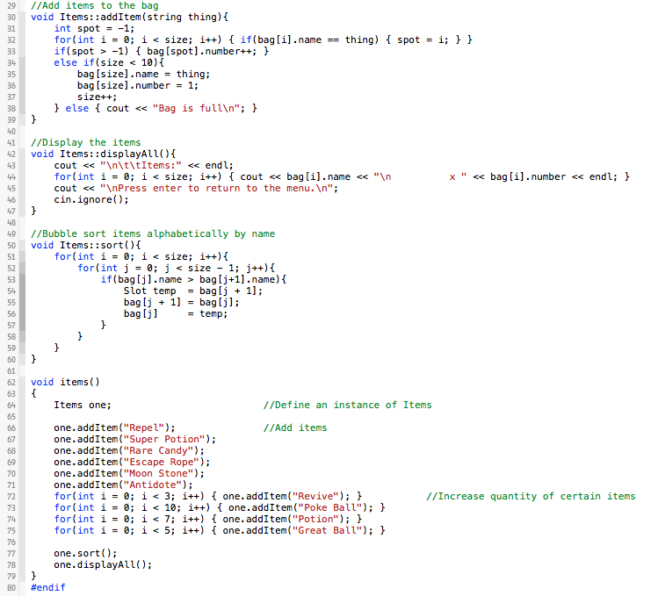
Case C.) Bag
The implementation of the functions used in the items class.
Last function adds items and the quantity to some items.

Slide 14
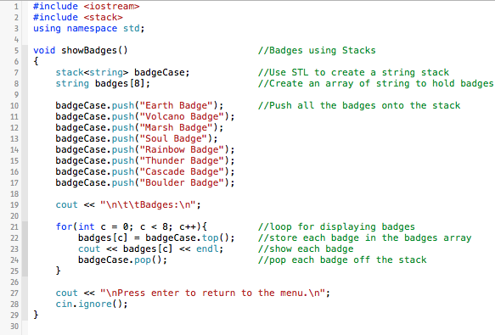
Case D.) Badges
When case D is picked, our show badges function is called which builds a stack for our Pokemon Badges

Slide 15
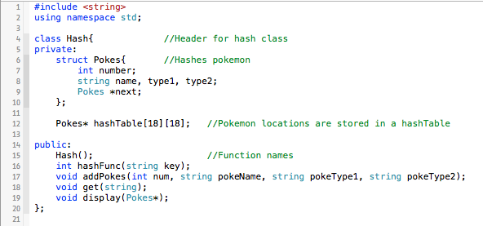
Case E.) Display By Type
Here is our hash class, which display a secific type of pokemon using hash functions

Slide 16
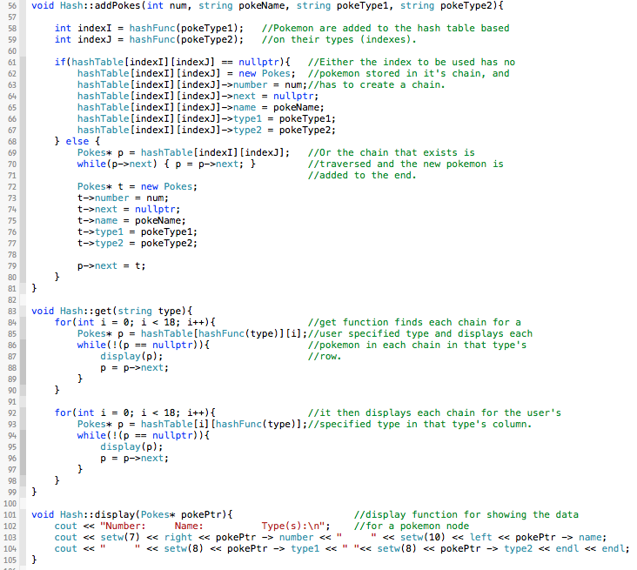
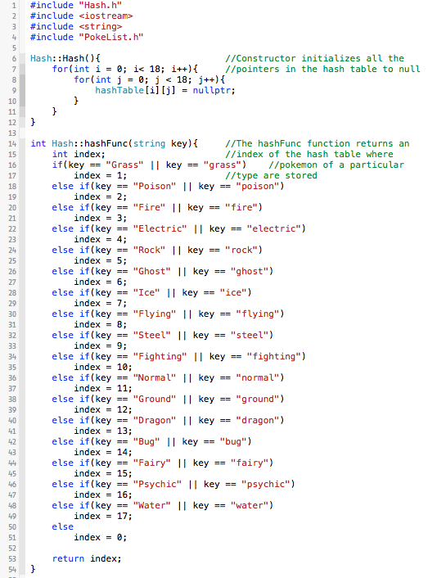
Case E.) Display By Type
Hash Implementation

Slide 17


